Slide 1
Scenarios on New and Emerging Risks to Occupational Safety and Health Associated with New Technologies in Green Jobs by 2020
GRAPHIC VISUALIZATIONS (by Joe Ravetz)
Notes:
Revised v0.6
29-02-12

Slide 2
Scenarios
‘WIN –WIN’
‘BONUS WORLD’
‘DEEP GREEN’

Slide 3
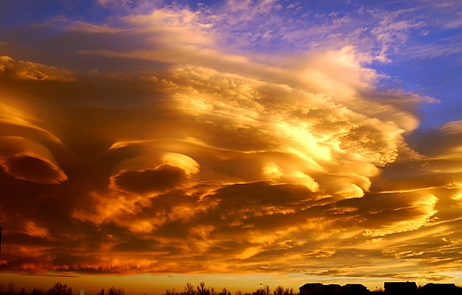
‘WIN-WIN’ scenario

Slide 4
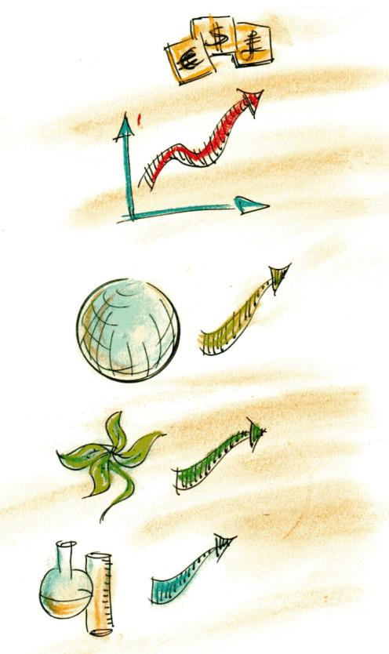
‘WIN-WIN’ - context
Economic growth
Holistic human development
Green
values
Strategic investment & rebuilding
Green innovation
Green = growth = prosperity
Other innovation
New frontiers & new applications

Slide 5
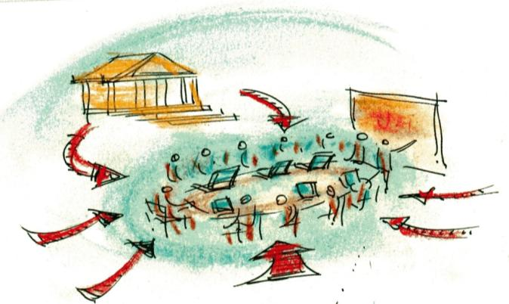
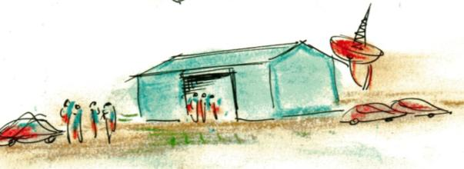
‘WIN-WIN’ - enterprise systems
Self-regulation by creative collaboration
Regulation by collective strategic thinking
Finance by active co-investment
Markets based on innovation frontier
‘Work’ is integral to social enterprise, culture & leisure
Business structures – collaborative & knowledge based
Continuous skill development & innovation
Ecology & ethics high priorities
“I remember when we had “jobs” .... Now we’re self employed knowledge network entrepreneurs”
“ Great – we could 3D-skype with our coordinators in Mumbai & Beijing”

Slide 6
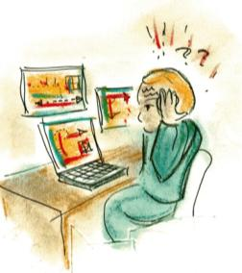
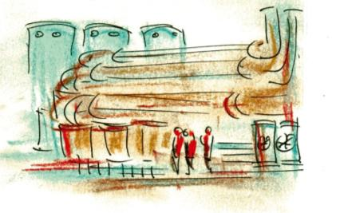
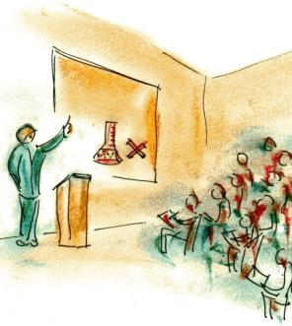
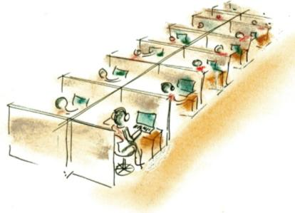
‘WIN-WIN’ - human systems
“Every day we continue to re-design the human-machine interface...”
“We scored 8 out of 10 in the last green audit… how can we do even better next time?”
“Welcome to the L.Z.C. Safety & Health @ Work training module. Today we look at everyday hazards...”
“I guess every smart grid needs a call centre but it’s still pretty stressful”

Slide 7
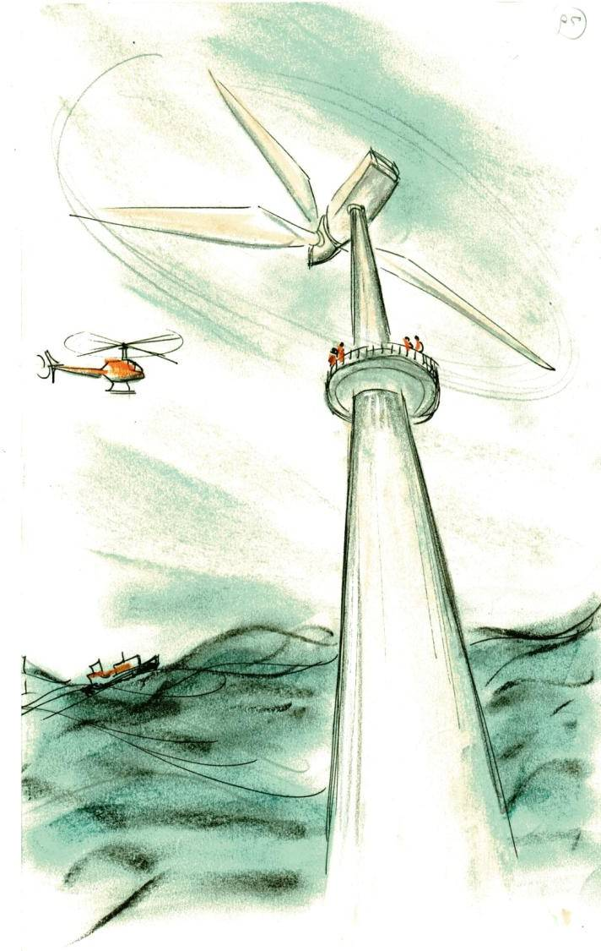
‘WIN-WIN’ – wind energy
“Delta Charlie to Base... I repeat... Storm force winds are forecast... Returning to the accommodation platform...”
“I wish the Green Job Policy Team was here.
They would then appreciate the challenges of working on these large turbines in this environment.”

Slide 8
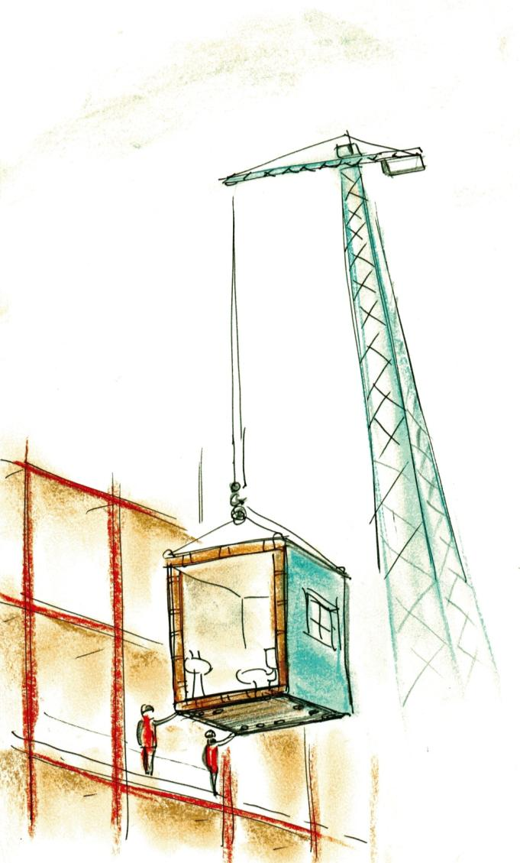
‘WIN-WIN’ – construction
“Construction ?? – it’s all ‘prefabrication’ these days. Much less manual work.”
“Yeah – look at this one - carbon epoxy fibre laminated cement extrusion, with all services installed. Just hope the ‘plug and play’ water and electricity connections are clearly labelled. “

Slide 9
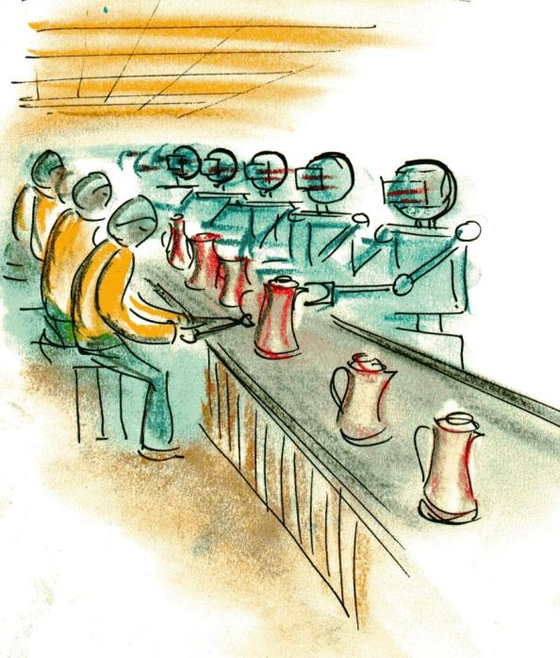
‘WIN-WIN’ – manufacturing
“Now that robots or “co-bots” do most of the work.... What’s there to worry about ???”
+++ THIS HUMAN HAS A POOR TRAINING RECORD+++ KEEP HER UNDER ACTIVE SURVEILLANCE +++
Boredom ... insecurity ... Keeping up with innovation ... And, what if they do not keep out of our way...

Slide 10
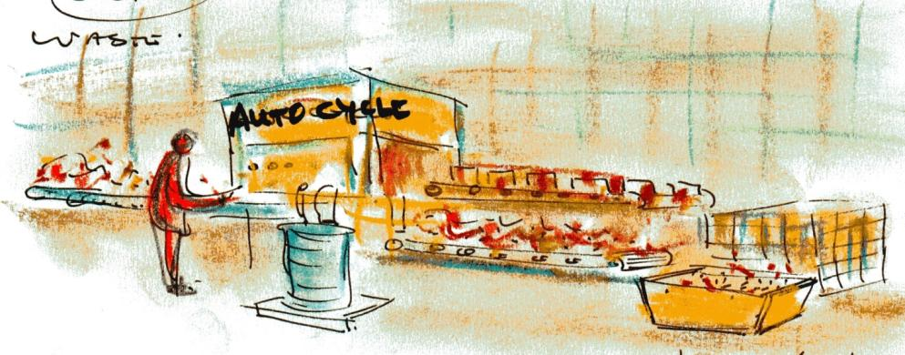
‘WIN-WIN’ – waste
Our automated waste recovery extraction and intelligent re-use technology is the best available...
But how do we know if new kinds of hazardous waste are getting into new kinds of places ???

Slide 11
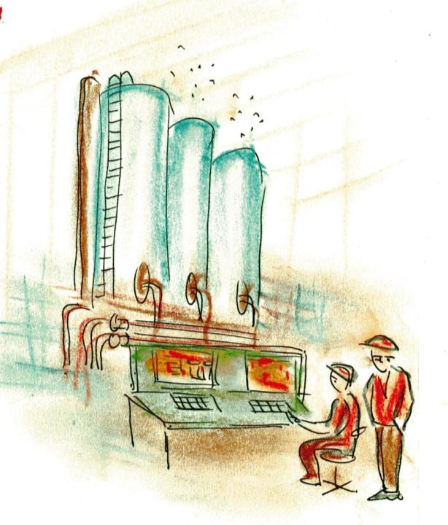
‘WIN-WIN’ – bio-energy
Well - according to the diagnostics, there should be no problem. The automatic risk assessment shows 99.99% safe...
But something isn’t right ...
So .... Have you thought about –
Shortage of skilled labour-
Non-zeroed instruments -
Outsourced consultants –
New maintenance schedule –
Out-of-date specifications -
Cost-cutting management –
Obsolete safety & health regulations ....
Unknown unknowns ????

Slide 12
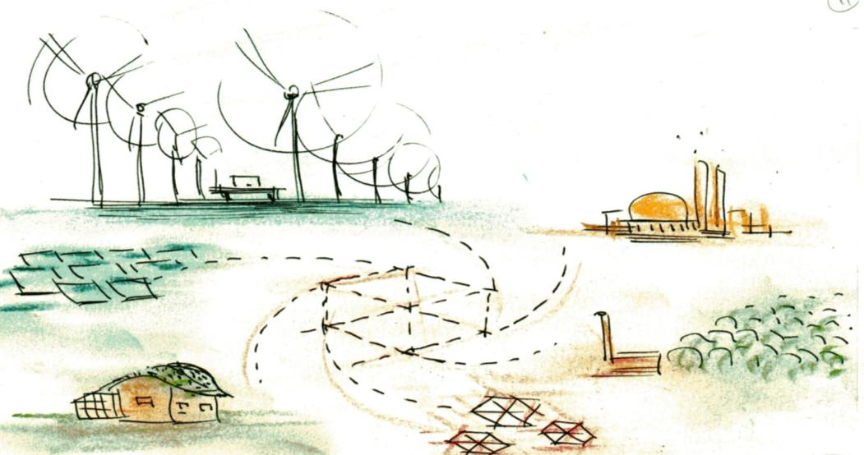
‘WIN-WIN’ – energy-systems
Larger scale wind turbine arrays seem to be everywhere
Large efficient generators and storage are part of a diversified energy mix
Homes combine hi-tech systems with natural cycles and materials
Smart grid solutions optimize supply / demand, flows and capacities

Slide 13
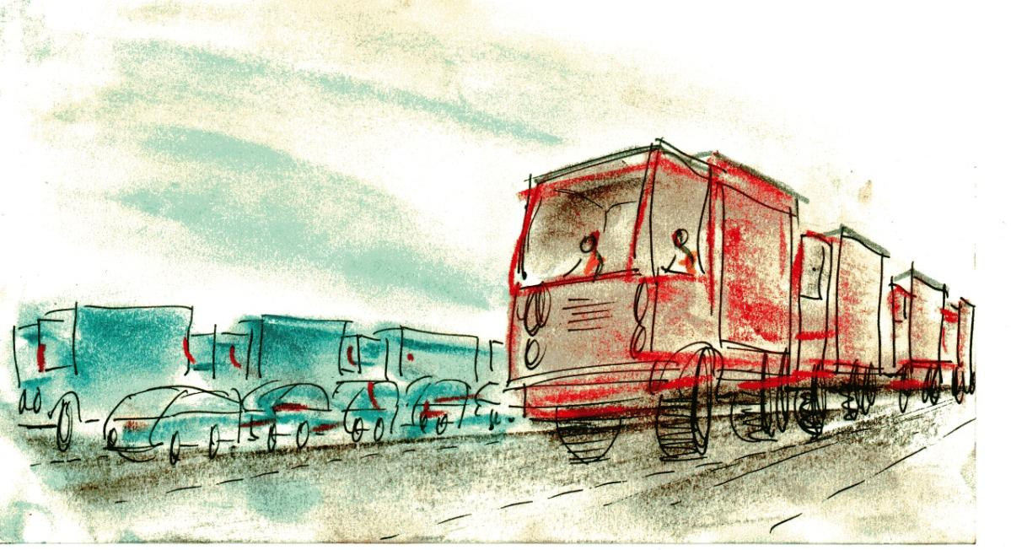
‘WIN-WIN’ – transport
Do you think this new “platoon” technology is going to be totally safe ??
How safe is safe ?? ... At least I can catch up on my e-mails whenever I want

Slide 14
‘BONUS WORLD’ scenario

Slide 15
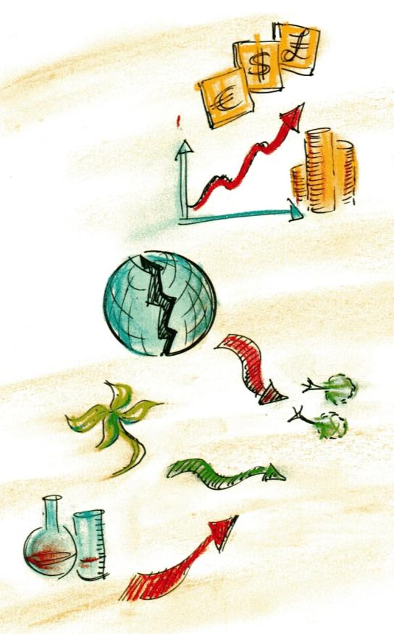
‘BONUS WORLD’ - context
Economic growth
Heading for the sky
Green
values
Negative outlook
Green innovation
Only where profitable
Hi-tech business is booming
Other innovation

Slide 16
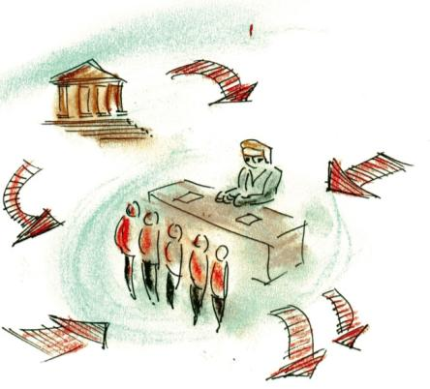
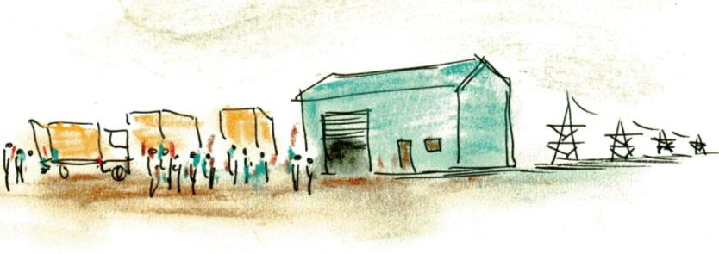
‘BONUS-WORLD’ - enterprise systems
Market pressures – very strong
Regulation - light
Business structures – short term & profit-driven
Labour – pressure of unemployment
Ecology & ethics - low priority
“There’s a lot of mobile cheap labour looking for work around here”
“Give us a job – we can work for less than that”

Slide 17
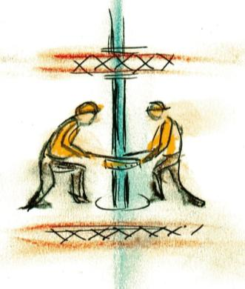
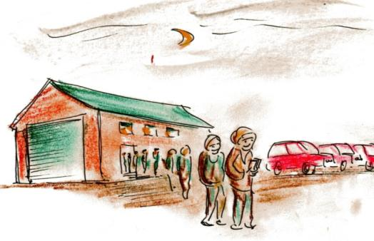
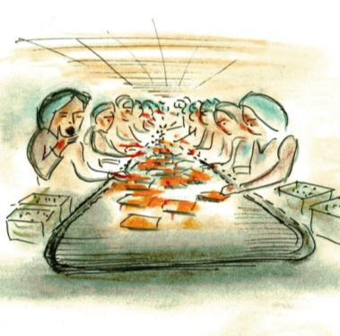
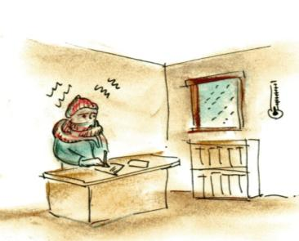
‘BONUS-WORLD’ – human systems
“Drilling at 4000m is easy... no-one can see anything, so you just get on with it”
“You seem to have good job satisfaction… it also pays for the new sports car”
“They call this the graveyard shift - 7pm to 7am ... lucky we’re allowed to go to the toilet at midnight”
“We’re freezing in here... Would love to invest in efficiency but that would reduce this year’s profits

Slide 18
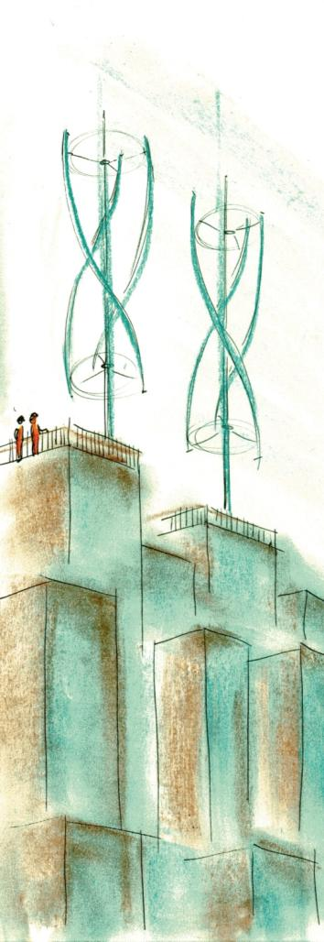
‘BONUS-WORLD’ – wind energy
… relaxed planning rules allow large energy companies to put turbines on apartment blocks...
Think about the profit we will make with these… they could not be more cost effective.

Slide 19
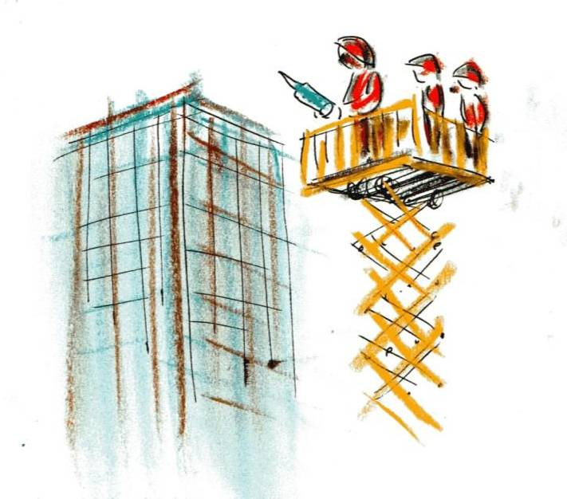
‘BONUS-WORLD’ – construction
Hey, this tube of sealant says “extremely toxic and hazardous”... So why are we not using a safer one ??
You better keep quiet if you want to keep your bonus...

Slide 20
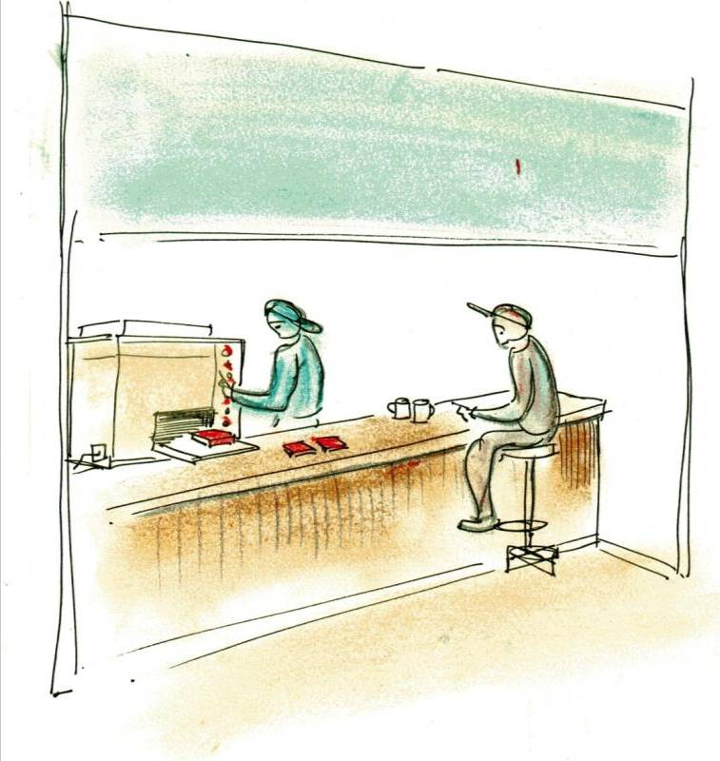
‘BONUS-WORLD’ – manufacturing
New Zpad v4.2
CUSTOM 3D-PRINTED WHILE-U-WAIT
“Hello - how may I help you??”
(....I used to work just in retail... Now I am expected to be a manufacturer as well. I just press the buttons and hope it is OK! )
I’ll have a Zpad4.2 ...
in lime green and purple ... and a cup of coffee while I wait please

Slide 21
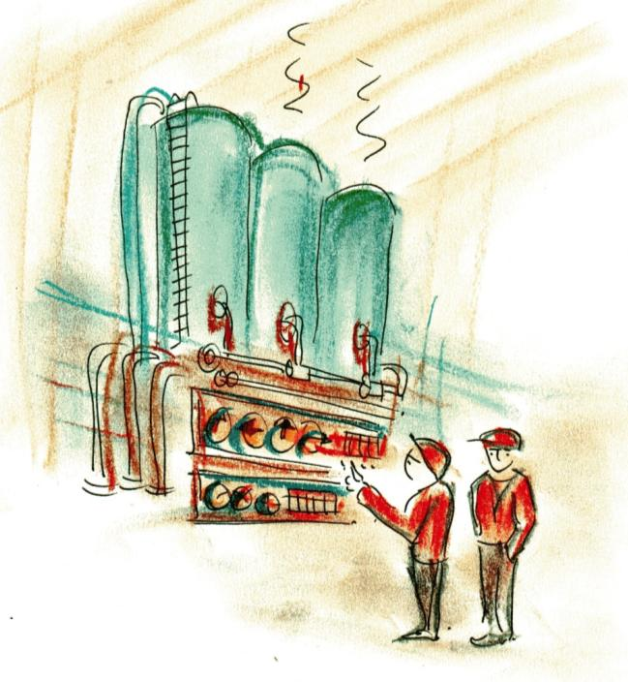
‘BONUS-WORLD’ – bio-energy
So – any idea what’s in Silo number 2 today??
No idea... But we got to get it out of here before the morning shift.

Slide 22
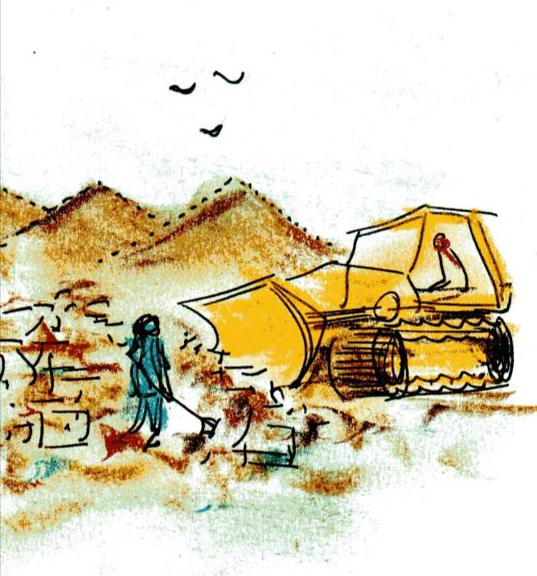
‘BONUS-WORLD’ – waste
Have you thought about investing in automated landfill resource extraction & recovery ?
Who needs to invest in automation when you’ve got all these cheap workers??

Slide 23
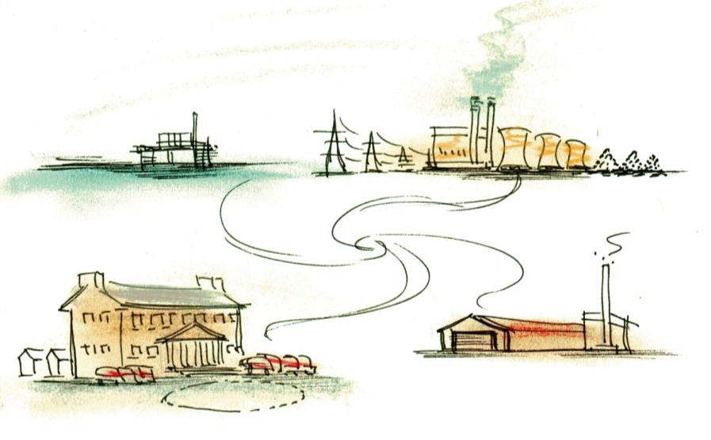
‘BONUS-WORLD’ – energy systems
Low cost fossil fuel extraction
Cheap & dirty fossil fuel energy
Large energy intensive housing & transport

Slide 24
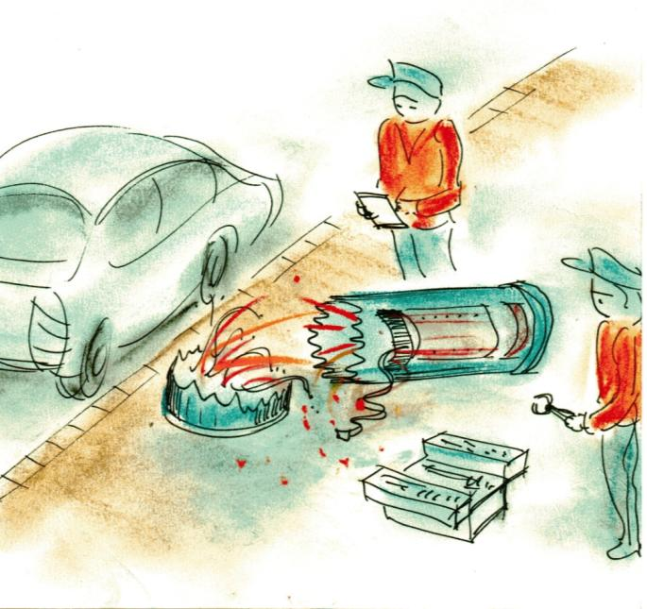
‘BONUS-WORLD’ – resource limits
… thieves will do anything to get a bit of copper and zinc out of the vehicle charging point
Problem for us is you don’t know which are the live wires..

Slide 25
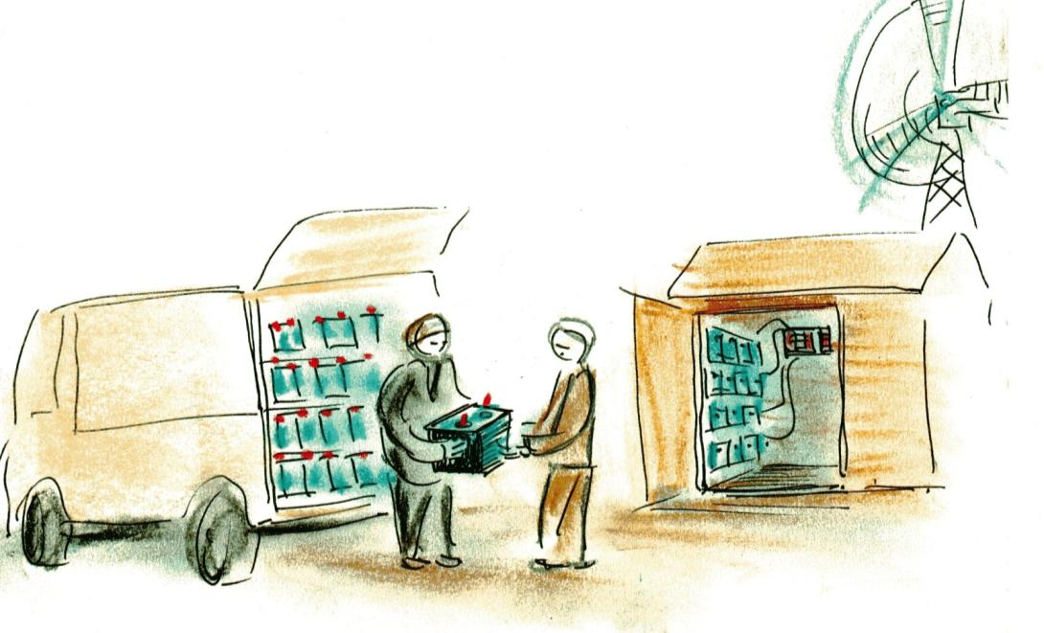
‘BONUS-WORLD’ – transport
Yes these ex-car batteries should be fine, no service record but never had any problem...
Ex-E.L.V. BATTERIES
Buy 2 get 1 free!!!
No need for guarantees... I just need 20 units for the home system

Slide 26
‘DEEP GREEN’ scenario

Slide 27
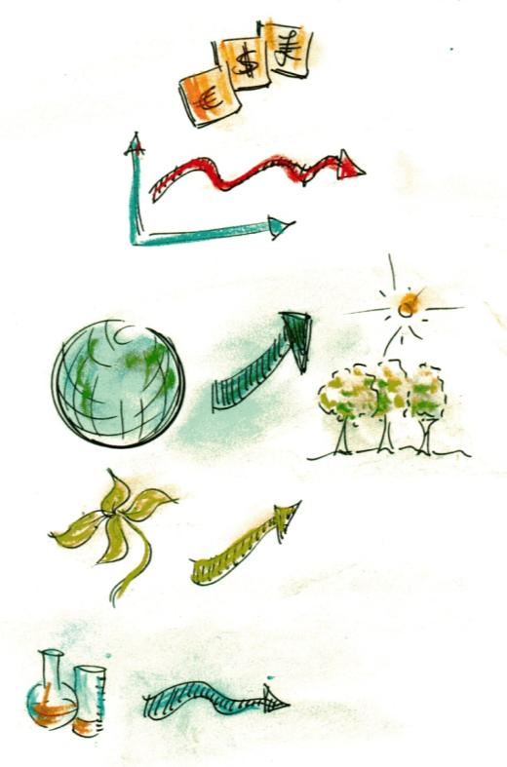
‘DEEP GREEN’ - context
Economic growth
Money is not top priority
Green
values
Abundance & diversity
Green innovation
For a green future
Other innovation
Not a priority in itself

Slide 28
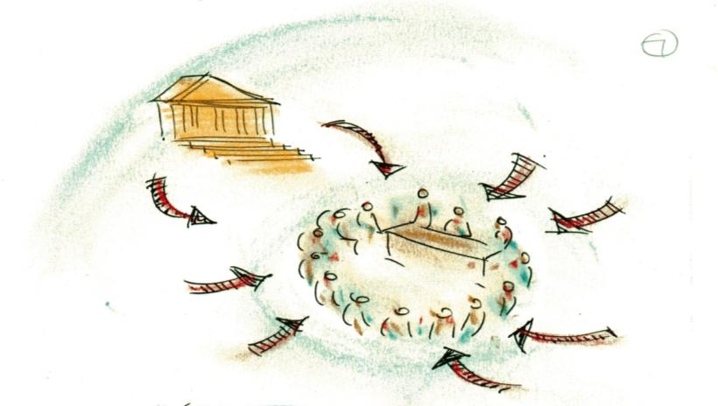
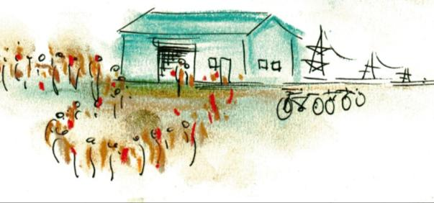
‘DEEP GREEN’ – enterprise systems
‘Green’ micro-
companies
Self-regulation by consensus
Finance from co-ownership
Regulation by consensus
Markets based on local demand
side pull
Training via intermediate labour
Ecology & ethics high priorities
”The committee would like to announce that our zero-zero waste-energy targets are now achieved”

Slide 29
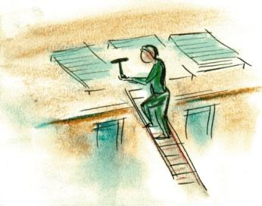
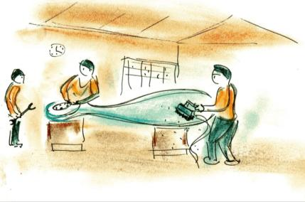
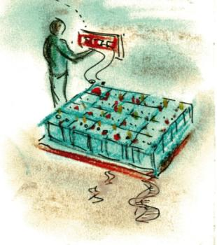
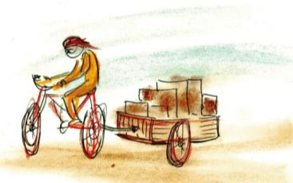
‘DEEP GREEN’ – human systems
“Welcome to the community wind energy cooperative …”
“Solar panels are great because they are ‘green’... You don’t need skills or qualifications, just get up there and do it”
“We can power the firm on these out-of-date ELV batteries... Remind me - is it the yellow or blue wire to white??”
“Everybody loves this green bicycle delivery service ... but the trailer gets heavier and heavier”

Slide 30
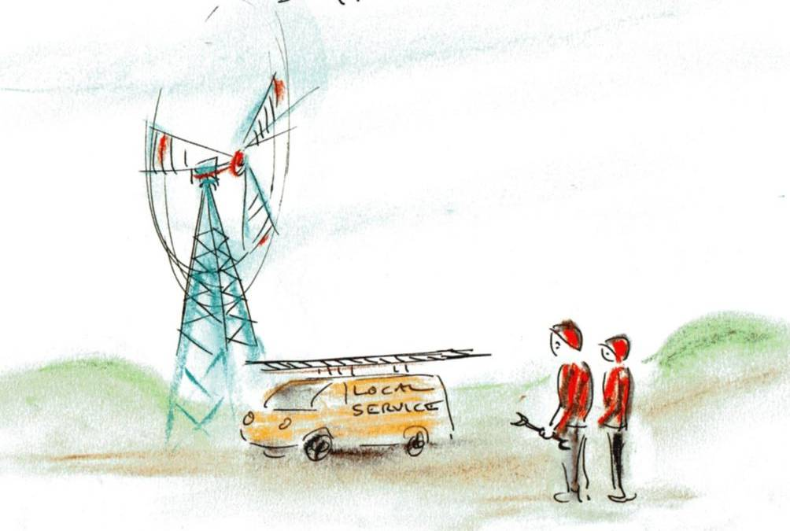
‘DEEP GREEN’ – wind energy
Look at that turbine – way beyond its design life !!
We can only get refurbished spare parts these days...
It is exhausting to spend all day climbing up these old turbines without lifts…
I wish we had new ones

Slide 31
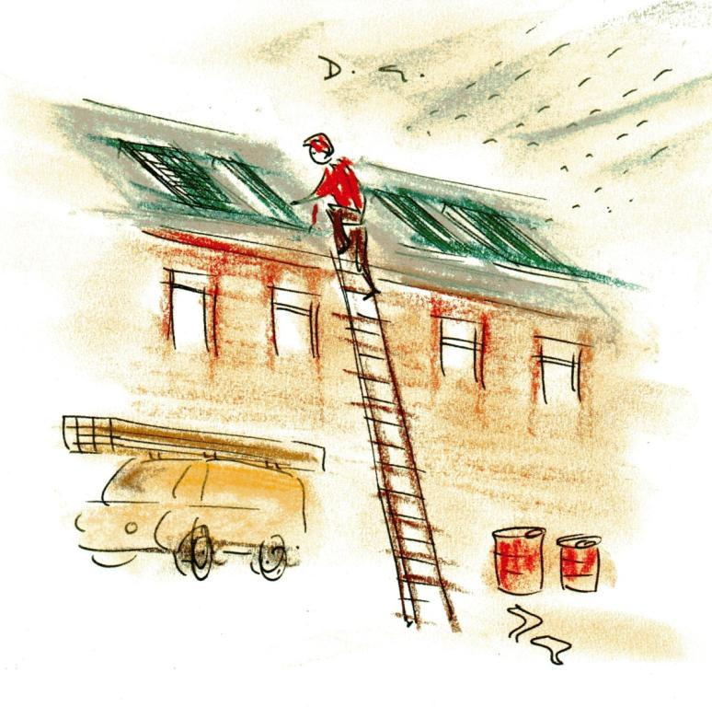
‘DEEP GREEN’ – construction
This “retro-fit photo-voltaic” programme is a job for life !!
Just mind out for the unknown substances and fibres in your lungs... Or else you could just slip in the rain & fall off the ladder first.

Slide 32
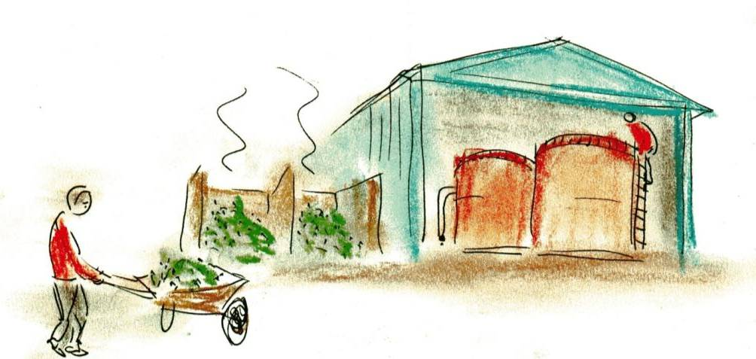
‘DEEP GREEN’ – bio-energy
“Your waste is my resource” ...
(but these wheelbarrows get heavier and heavier...)”
HEY –wish we knew what is being put in here!!

Slide 33
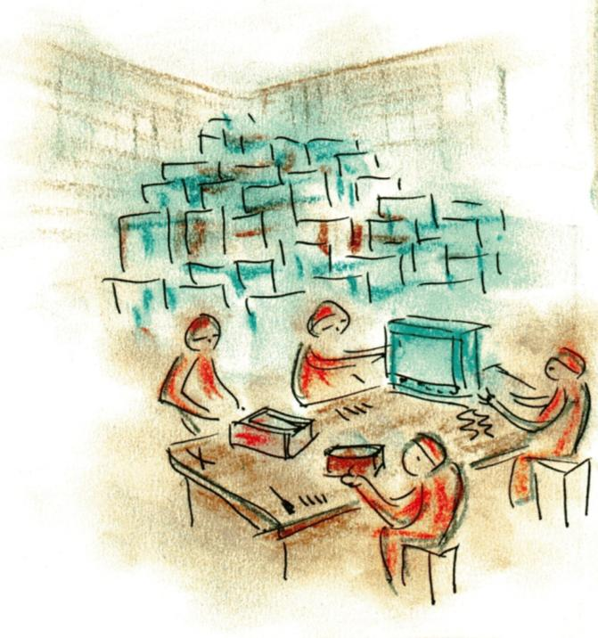
‘DEEP GREEN’ – manufacturing
Today it’s plasma TVs – very hi-tech.... Tomorrow, washing machines and hoovers. Day after... Radios and alarm clocks.
Yeah right – who needs the latest model when you can fix anything you want ??

Slide 34
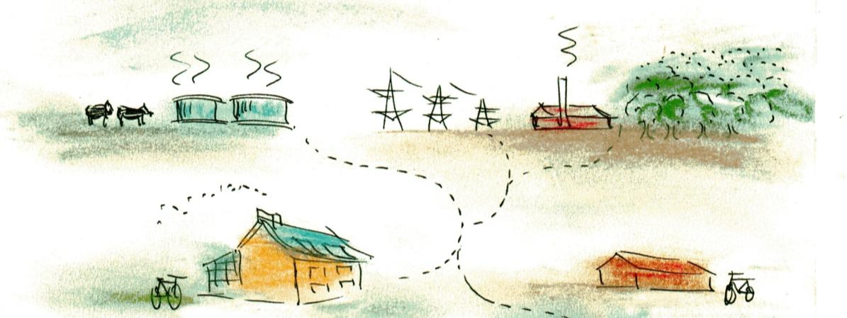
‘DEEP GREEN’ – energy systems
Local bio-gas with livestock management
Bio-mass landscapes with community power generation
Autonomous housing with micro-generation
Integrated industrial ecology systems

Slide 35
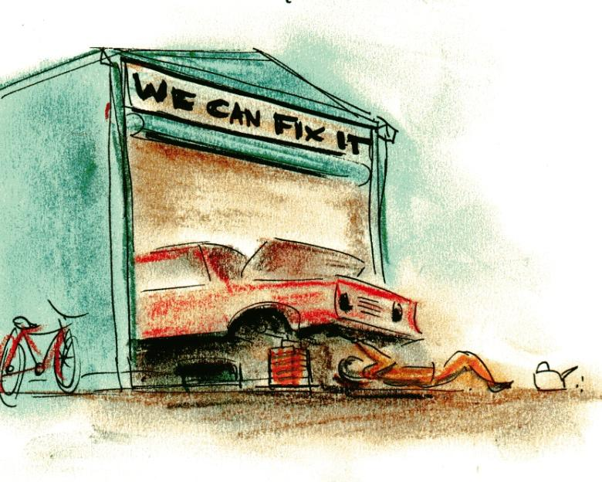
‘DEEP GREEN’ – transport
If you can’t get the spare parts, you can always bend some metal into shape...
“There’s no vehicle that can’t be repaired”... That is, if you give it enough love...

